Slide 1

Orphan Drug Global Incentives & Regulatory Framework
Marlene E. Haffner, MD, MPH
CEO, Haffner Associates, LLC
Orphan Drugs Summit 2012
Thursday, 27th September 2012

Slide 2
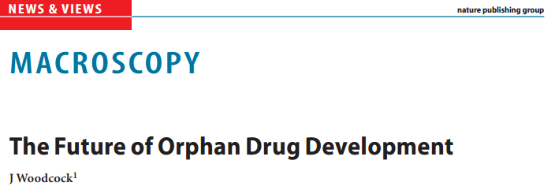

Slide 3
Current Pharma Trends
Slow pharma industry growth
Patent expiration
Generic Competition
Drying Pipelines
Biosimilars
Regulatory Guidelines
Lack of Investor Interest
Reduction in ROI
Lack of Success
Economic Uncertainty
Orphan Products Save the Day!?
Notes:
Orphan drugs could enable pharma companies to develop newer areas of therapeutics, diagnosis, treatment, monitoring, and patient support while also solving some of medicines tougher issues.

Slide 4
Orphan Drug Development Challenges The rarity paradigm
Limited public awareness (invisible patient population)
Scarcity of clinical expertise and reference centers – disease is poorly understood; no natural history
Delay in diagnosis
Small patient population – difficulty in recruiting to clinical trials
Geographic dispersion
Life threatening/chronic
Heterogeneous conditions
Difficult to stratify/stage – lack of natural history of disease
Limited treatment availability

Slide 5
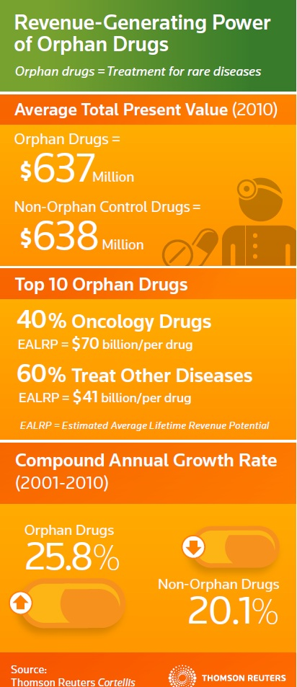

Slide 6
Entering Orphan Drug Market
Public Health
Economies of Scale
R&D Drivers | Commercial Drivers
Tax Credits | Favorable reimbursement
R&D Grants | Fewer hurdles to approval
Filing fees reduced or waived | Longer/stronger exclusivity
Shorter development timelines | Lower marketing costs
Greater Regulatory Success | Faster Uptake
Global Support | Premium Pricing
Source: Thomson Reuters Newport Premium, IMS Health
Notes:
Over the years the medial community has attempted to tackle some of the most devastating common illnesses.
The thought behind the investment was that if you made a drug that could be sold to the masses you would receive a nice return on investment.
Now the tides have changed and the return on investment favors orphan drug products.
If a pharmaceutical company can develop a successful drug with a successful vector/process for a orphan designated disease then the opportunities are endless for other orphan designated diseases.
Success in approval in one region of the world can lead to approval in other regions.

Slide 7
Who has Orphan Drug Policies
US – the first 1982/3
Singapore – 1991
Japan – 1993
Australia – 1998
EU – 1999/2000
Taiwan, S. Korea, Hong Kong, S. Africa, Turkey, India…

Slide 8
Orphan Medical Product Designation
Designation
US
EU
Japan
Notes:
US
Done through the Office of Orphan Products Development
Submit Request for orphan drug designation
Statement identifying the request with specificity
Sponsor contact information
Description of rare disease for which treatment is being developed as well as why therapy is needed
Drug description and supporting documentation on its effectiveness for particular rare disease
If a subsequent drug has been developed and obtained orphan drug designation then an explanation must be given for why the current application is better than previous
Where a drug is under development
A summary of the regulatory status and marketing history of the drug in the United States and in foreign countries.
Supporting evidence that it affects less than 200,000 in the US, if more then 200,000 then proof that the R&D will be greater than future sales in US.
Information previously provided by the sponsor to FDA under Subpart B
Review done within two months
Response Yes/No/More Information
EU
Done through The European Medicines Agency
Submit application to the agencies Committee for Orphan Medicinal Products
Once a positive opinion is given the European Commission reviews it
Once granted incentives start to kick in
Assistance with the development of the medicine
Reduced fees for marketing –authorization applications
Protection from market competition once medicine is authorized
Designation is done centrally not separate by state
Japan
Designated by the Minister of Health, Labor and Welfare
Reviewed by Pharmaceutical Affairs and Food Sanitation Council (PAFSC) for +/- options
Designation of orphan drugs/medical devices does not automatically lead to marketing approval.
Incentives
Subsidy payment
Guidance and consultation
Preferential tax treatment
Priority review
Extension of re-examination period

Slide 9
US Orphan Drug Policy
Orphan Drug Act (1983)
Rare disease = prevalence < 200,000
7 Year Market Exclusivity
FDA Filing Fee Wavier
Tax Credits for clinical trials
Orphan Product Grants
400+ drugs approved; >2200 designated
Use of accelerated approval/fast track
Notes:
Tax credit is 50% of clinical trials
Grants mainly through NIH

Slide 10
EU Orphan Drug Policy
Orphan Drug Regulation 141/2000 (1999)
Rare disease = prevalence < 5 per 10,000
10 Year Market Exclusivity (6 + 4 years)
Must be Serious or Life threatening disease
Free Protocol Assistance; partial waiver filing fee
Tax credits by member state
Grants via 8th Framework
COMP designates – 38 members
chair, 1 from each MS, 3 patient organization members, 3 from CHMP, 1 each Norway, Lichtenstein, Iceland, 1 from EC
864 designated; 68 approved orphan drugs
Notes:
Reapplication is every six years

Slide 11
Japan’s Orphan Drug Policy
Orphan Drug Regulation
Pharmaceutical Affairs Law Amendment (1993)
Rare disease = prevalence < 50,000 (Population 120 million)
10 Year exclusivity
Various Tax Incentives
50% reimbursement of development cost
Designation must be for incurable disease with no alternative treatment
Marketing authorization via fast track
Notes:
6% tax credit for any type of study and up to 10% corporate tax

Slide 12
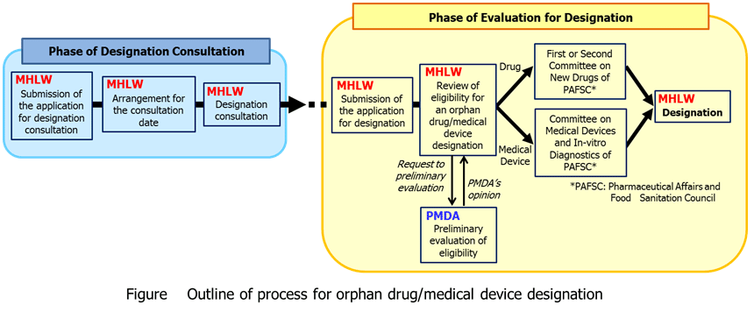
Japan
Source:MHLW Orphan Product Designation System

Slide 13
Other Nations
Nation | Programs | Challenges
India | Indian Drugs Manufactures Association(2001) requested the government to institute the Orphan Drug Act. | Enforcing Patent Laws and Market exclusivity
Taiwan | Rare Disease and Orphan Drug Act (2009) 159 classified rare diseases 77 approved orphan products | Regulation Efficiency Safety Measures Local drug development
South Korea | Designation = Prevalence < 20,000 and diseases with no treatment in Korea 130 Orphan products approved | Regulation through KFDA Usage limitations
Hong Kong | New Chemical Entity Registration Process | Process Time
Singapore | Singapore’s Medicine Act -Inactive | Definition is unclear; there is mentioning yet no details
South Africa | South African Foundation for Rare Disorders | No strength, compliance, funding
Australia | Designation = Prevalence < 2,000 Focused on particular populations | Not defined in law
Source: Sharma, Abraham, Manas, & Dushyant. "Orphan Drug: Development Trends and Strategies."
Notes:
An orphan drug applicant may register their drug under the New Chemical Entity (NCE) registration process, which was established for new, life saving drugs. (Quick review)
The SAFRD was established with the assistance of Genzyme Biopharmaceuticals South Africa at the end of 2008.

Slide 14
Global Cooperation
Improving – orphan diseases do not know territorial boundaries
Approval Process – can have joint US/EU review and approval. Is cumbersome
OOPD and COMP – regular meetings
Designation application – US/EU – same format
Not always aligned on definition of “what is the disease”
Obvious differences in population requirements – surrogate for profitability
EMA and MHLW/PMDA (Pharmaceuticals and Medical Device Agency)
Notes:
In Taiwan, pharmaceuticals designated as orphan drugs are not required to undergo clinical trials for approval in Taiwan as long as the drug has already been approved by the US FDA.
TGA publicly acknowledge the enormous support obtained from the Food and Drug Administration (FDA) Office of Orphan Drug Products in constructing the Australian program.
EMA has confidentiality arrangement with FDA where they share information on orphan medicines.
The two authorities have also developed common procedures for applying for orphan designation and for submitting annual reports on the status of development of designated orphan medicines.
Under the confidentiality arrangements between the EC/EMA and MHLW/PMDA where goals are:
Creation of greater awareness of mutual orphan medicine designations submission process.
Development of a system of exchange regarding the outcomes of orphan medicine designations in each Agency/Ministry.
Development of a system of exchange regarding regulatory and licensing stage concerning orphan medicines.
Development of a system of exchange regarding pharmacovigilance post-licensing activities associated with Orphan medicines.
Development of a collaboration mechanism regarding small to medium size enterprises (within the range of confidentiality arrangements).
Meet on a quarterly bases via teleconferences

Slide 15
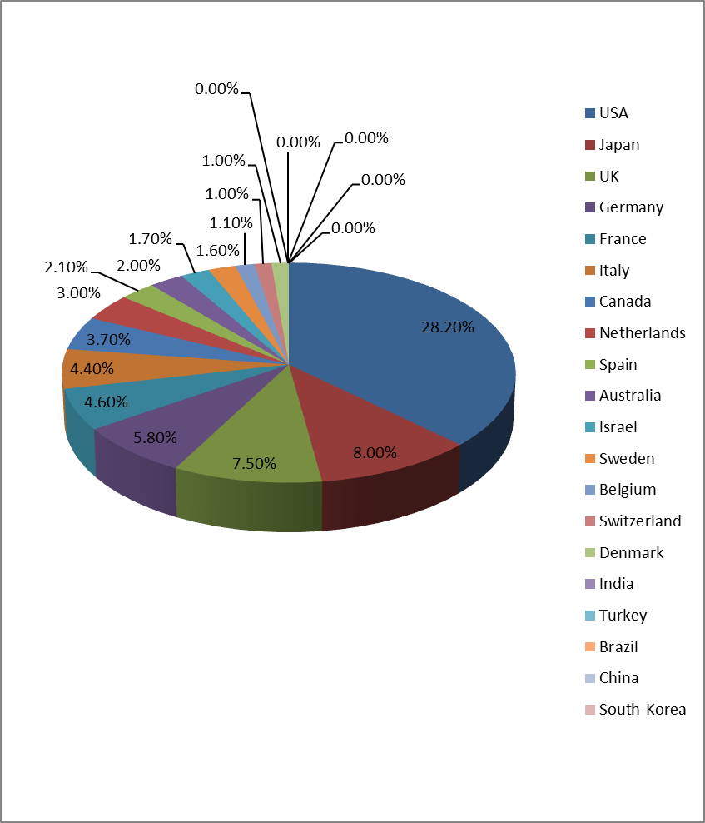
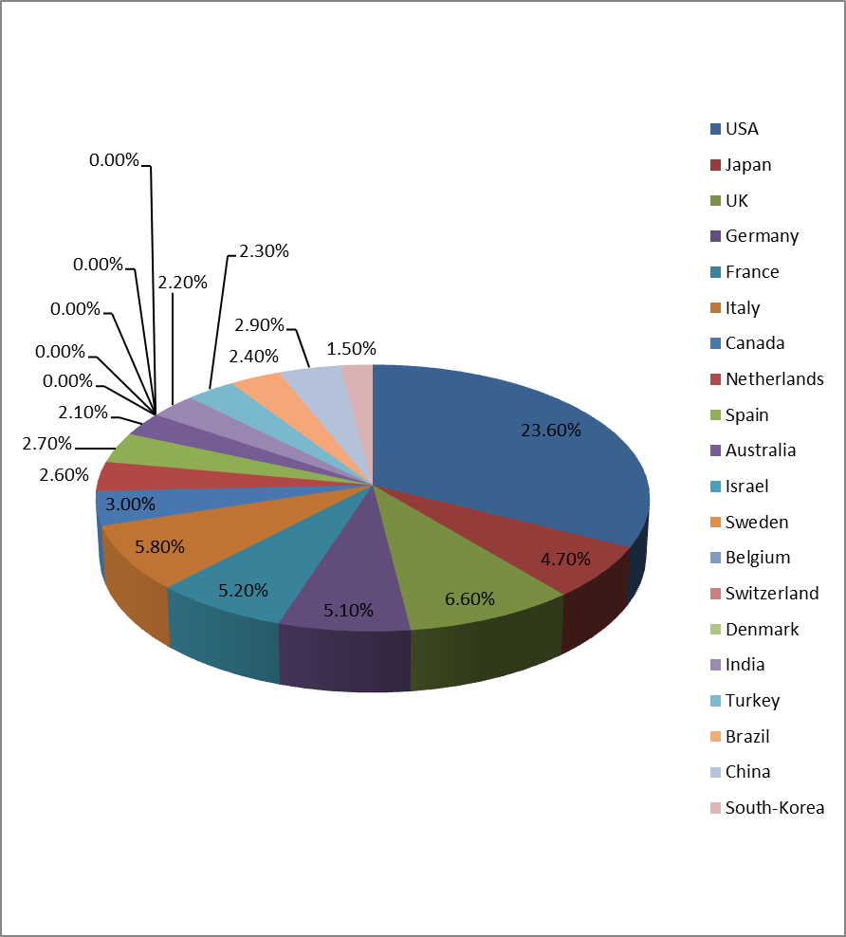
Relative contribution of Top-15 countries to the total scientific output for the 88 rare metabolic disorders†
1996-1998
2009-2011
OUT
IN
† De Vrueh, Remco. "China Has Joined the Fight against Rare Disorders."
Notes:
† De Vrueh, Remco. "China Has Joined the Fight against Rare Disorders." Web log post. Rare Disease Matters. N.p., 30 June 2012. Web. 31 Aug. 2012. <http://www.rarediseasematters.org/2012/06/china-has-joined-the-fight-against-rare-disorders/>.

Slide 16
Latest Orphan Drug Development
Glybera – first Gene therapy. Recommended for approval by CHMP. Awaiting EC approval
Gevokizumab
Multikinase inhibitor lenvatinib mesylate – thyroid CA – approved in Japan. US/EU studies ongoing
Hemophilia B – AMT – also gene therapy. Not yet approved
Notes:
Treats liproprotein lipase deficiency (EU orphan designation March 2004 , US 2007)
Uses vector derived from AAV
27 patients in clinical trials
Has gone through 3 submissions and has obtained positive opinion from EMA committee (CAT)
Gevokizumab granted orphan drug status for an inflammatory eye disease late Aug 2012
focuses on shutting down inflammation brought on by a type of cell-signaling protein called interleukin-1 beta
Multikinase inhibitor lenvatinib mesylate
Treats thyroid cancer
potent inhibitor of the VEGF (Vascular Endothelial Growth Factor) receptor, VEGFR2, RET (Rearranged During Transfection), and a number of other types of kinases involved in angiogenesis and tumor proliferation
Approved by Japan’s Ministry of Labor, Health and welfare
Currently conducting Phase III studies with lenvatinib in patients with radioiodine-refractory differentiated thyroid cancer (DTC) ; global development program that encompasses the United States, Europe, Japan and other parts of Asia, with the aim of submitting marketing authorization applications for the agent before the end of fiscal 2013
treatment for endometrial cancer, melanoma, glioma and non-small cell lung cancer, primarily in the United States and Europe, in addition to a PhaseI/II study in hepatocellular carcinoma (HCC) in Japan and Asia.
http://www.eisai.com/news/news201256.html
Less common than A; 1:5,000 males (X-linked inheritance)
Current treatment is IV Factor-IX injection 2-3 wk
2010 study presented at ASH-AAV8 vector with self-complementary gene encoding a codon-optimized FIX gene under control of a liver promoter (no immunosuppresion)
4/6 patentis had positive outcome
Mild AE’s
Currently undergoing several trials

Slide 17
Working with the regulatory agencies
Approval requirements same for orphan products as for non orphan products.
Product must be safe and effective for its intended use
Not always easy to demonstrate
Frequent post-marketing commitments
Most frequent products are: Metabolic/endocrine; inborn errors; oncology; neurology
80% genetic
90 % Serious and/or life threatening (US); 100% serious/life threatening (EU)
50% children

Slide 18
Working with the regulatory agencies
Difficulty in designing adequate clinical trials for such small populations – need excellent statisticians
EU has white paper
FDA will have guidance
May have a preponderance of patients in a member state/nation
Founder effect
Cultural norms

Slide 19
Working with the regulatory agencies
Protocol assistance/pre-IND meetings – used in US and EU and Japan. No charge
FDA – Office of Orphan Products Reviews designation and Review Division grants product approval. Consult with each other. Office of Rare Diseases in CDER – works with orphan product policy in CDER
EU – COMP reviews designation with concurrence by EC. Approval by CHMP with concurrence by EC
Concordance between EU and US probably >90%
Differences with disease definition
And population numbers
Designation consultation with MHLW Japan - frequent

Slide 20
New US Legislation - 2012
PDUFA 5/FDASIA – Section IX
To implement more effective processes for expedited development and review of innovative new drugs to meet unmet needs § 901 (a)
Expands Fast track – “serious and life threatening disease or condition”
Accelerated approval - expands clinical benefit beyond usual surrogate endpoints to include epidemiological, pathophysiological, therapeutic, pharmacologic or other evidence developed using biomarkers

Slide 21
New US Legislation
Do the new provisions make a difference?
Allows FDA to do what it has been doing already
Helpful for Orphan Products
Helpful for new FDA reviewers
FDA may also withdraw products more easily

Slide 22
Moving Forward
Big PhRMA increasing involvement in Orphan Product Development
Asian Markets - emerging
Gene therapy – on the horizon
Improvements in Diagnosis/Treatment/genetic markers
Need for more Natural History Data
Issues of Access/Cost - especially in individual Member States
New platforms
Chronic therapy – long lived products
Over all - exciting, new technology, serving unmet needs for millions world wide!
Notes:
Companies
Pfizer
GlaxoSmithKline
Novartis
Sanfio-Aventis
Roche
Johnson and Johnson
Merk and Co
Eli Lilly
Bayer
Genzyme
Acetlion
With growing wealth and vast population Asia will become a critical market for orphan drug development. Establishing orphan drug legislation for some Asian countries will be difficult yet necessary for advancements in orphan product development.
Gene therapy currently faces many obstacles in drug development, but with advancement in both gene identification and targeting as well as vector mechanisms, gene therapy can assist in treating orphan diseases.
Identifying individuals with rare diseases will not only give these individual a means of treatment, but will also assist in the development of new orphan products.
Data –too much of it has become a big problem for various industries. With orphan drug product development data seems to not only be limited, but decentralized.
Initiatives are being made by several agencies to centralize information as well as share information with other agencies.

Slide 23

Marlene E. Haffner, MD, MPH
President & CEO
11616 Danville Drive
Rockville, Maryland 20852
mhaffner3@verizon.net
301 984 5729 - office
301 641 4268 - cell
301 984 2272 - FAX

