Slide 1

Orphan Products Rare Diseases 30 years and Moving quickly Marlene E. Haffner, MD, MPH CIBERER 31 January, 2012 Madrid, Spain mhaffner3@verizon.net

Slide 2
Orphan Products – What are they What is a rare disease
In the US – a rare disease is defined as affecting
< 200,000 patients in the US. In the EU – is defined as
< 5/10,000
Concept developed as a result of the cost of drug development post 1962/Thalidomide
US Orphan Drug Act passed in 1982; signed in 1983 by US President Reagan
Other countries began to follow: Japan, Singapore, Australia, EU (1999)

Slide 3
In the beginning
Concept included such diseases as Huntington, Tourette, Restless Leg Syndrome, nephropathic cystinosis
Scope of rare diseases was not known
Enter NORD – National Organization for Rare Diseases
EURORDIS – European Organization for Rare Diseases
FEDER – Spanish Federation Patient Association
Put a person’s face to a laboratory diagnosis

Slide 4
As it evolved
Pediatrics came to the fore
Most rare diseases are serious and life-threatening/life shortening; 50 % Pediatric
Genetic Diseases became a focus – Severe Combined Immunodeficiency Syndrome; OTC deficiency
Size of the US population ranged from 14 – 192,000 patients with a rare disease – no disease is too small
Diseases included: PKU, SCID, Morquio, MPS diseases, leukemias, some lymphomas, and…

Slide 5
What does the Orphan Drug Act offer to drug developers
Incentives
Protocol assistance – for drug development
Seven years (US) 10 years(EU) exclusive marketing for that drug for that disease
Tax incentives - in the US. By member state in the EU
Waiver/reduction of dossier filing fees
Free scientific advice
Grants assistance to academia – 7th Frame work program in the EU

Slide 6
Increasing number of Patient Organizations
Work together with researchers and drug sponsors
Have great knowledge of the disease as it affects them
Have even begun companies – Extraordinary Measures - Amicus, Inc
Patient organizations working together with Industry and Researchers – United Leukodystrophy Foundation

Slide 7
Orphan Products
More than 7,000 rare diseases – number growing by the week. See: www.orpha.net
Almost 400 US drugs for orphan diseases have been developed since 1983; more than 2500 designated and in development; 63 approved and 900 designated in EU
Burgeoning field – large and small companies involved
Money to be made
Review times may be faster because majority of orphan diseases are serious or life threatening diseases

Slide 8
Involvement of big and small companies
Early large Pharma not interested
SMEs arose and some are now big Pharma
Genzyme, Genentech, Biogen/Idec, Amgen
Now interest of Novartis, Pfizer, GSK and more
Orphan products, genetic research, understanding of disease causation and mechanisms is increasingly important
Works best when there are partnerships – patients, research, industry, government

Slide 9
Biotech and Genetics – as therapy
Greatly advanced by Orphan Drug legislation/Regulation
For the first time cures for diseases may be on the horizon
Partnerships between: research/industry/patients/government – each has an important role
Partnerships between – US/EU and to an extent other countries with orphan drug programs – Japan, Taiwan, S. Korea, Turkey, Israel, and more

Slide 10
Biotech and Genetics
Safety of drug products enhanced by Biotech
Description of the human genome gave rise to both the description of new diseases, the understanding of diseases, and causation of diseases
Still need natural history of these diseases
The potential into the possibility of real effect on the disease – turn off and on certain genetic mechanisms
Gives meaning to the term “personalized medicine”
Provides an entirely new approach to disease mitigation

Slide 11
And so since 1983--
Orphan disease issues are an idea whose time has come
Cutting edge technology has arisen from orphan study –
pegylation,
liposomal encapsulation,
gene expression vs non-expression for the utility of certain drug products; stop codon diseases
More and more rare diseases described
More and more treatments found – almost 400 approved in the US
More and more international organizations formed to emphasize and understand rare diseases – ICORD, IRDiRC, and more

Slide 12
What can Ciberer do
Think globally; act locally
Patient driven approach – large unmet medical need
Liaison with other international and regional networks
Industry is very important – integral to product development
Government – always present – funding and regulatory oversight. Need to provide long term financial support
Translational Research - every one working together. Move from bench to bedside

Slide 13
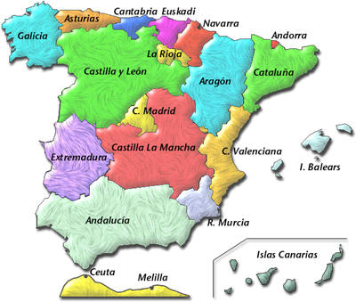
Muchas Gracias por su atencion

